Slide 1
Color Chooser Program Tutorial

Slide 2
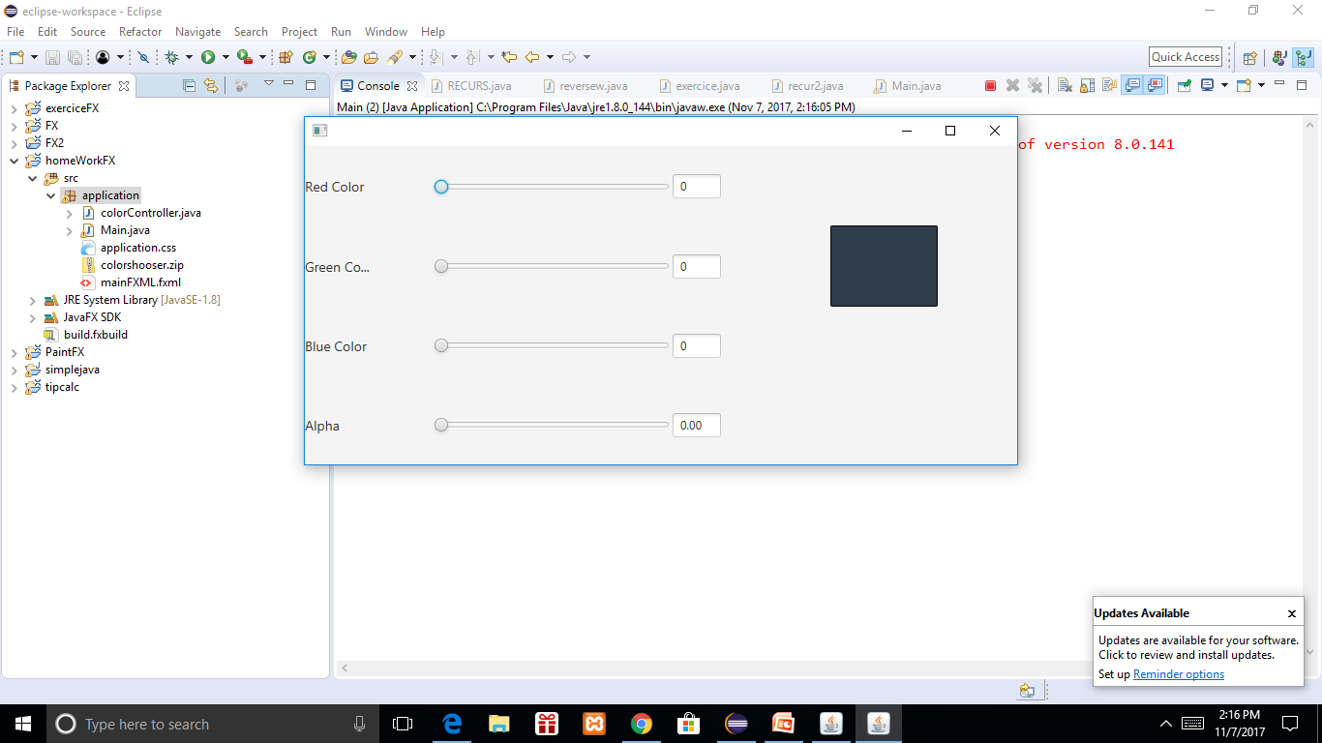
functionalities
This is what the final result should look like at first glance.

Slide 3
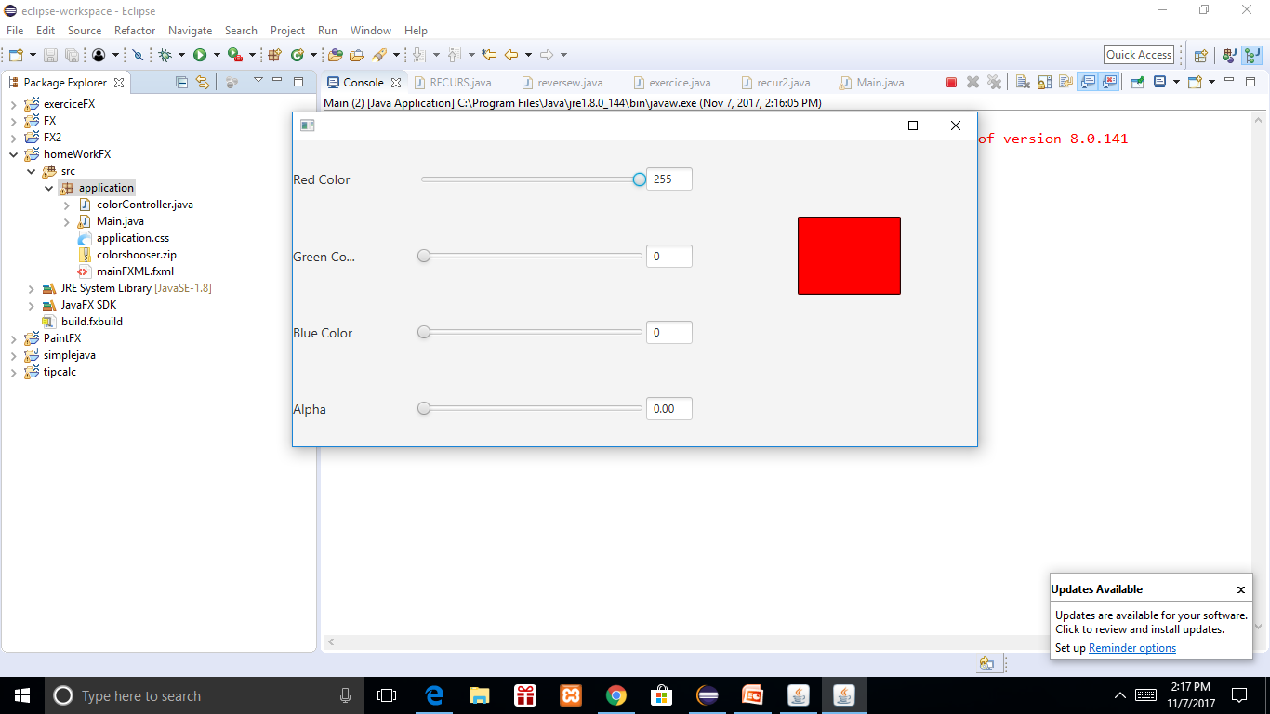
As you can see, when sliding the selected slider forward it changes the color
Of the rectangle.

Slide 4
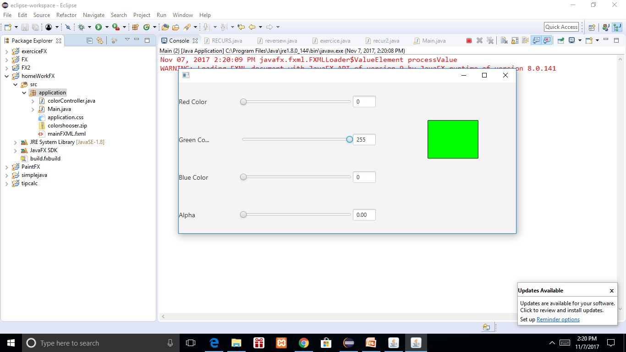
Like when changing the green slider for example.

Slide 5
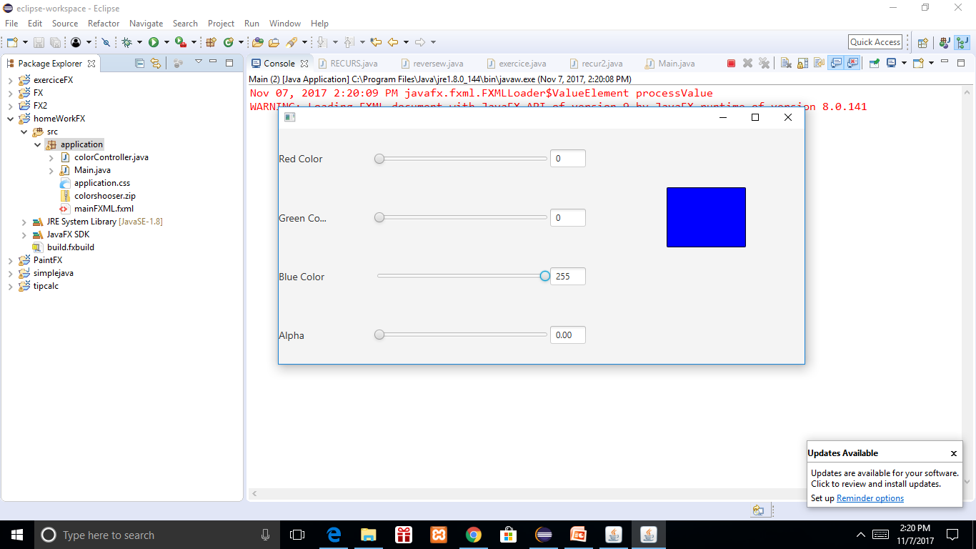
The blue slider also works like the red and green but the “Alpha” slider works a bit differently.

Slide 6
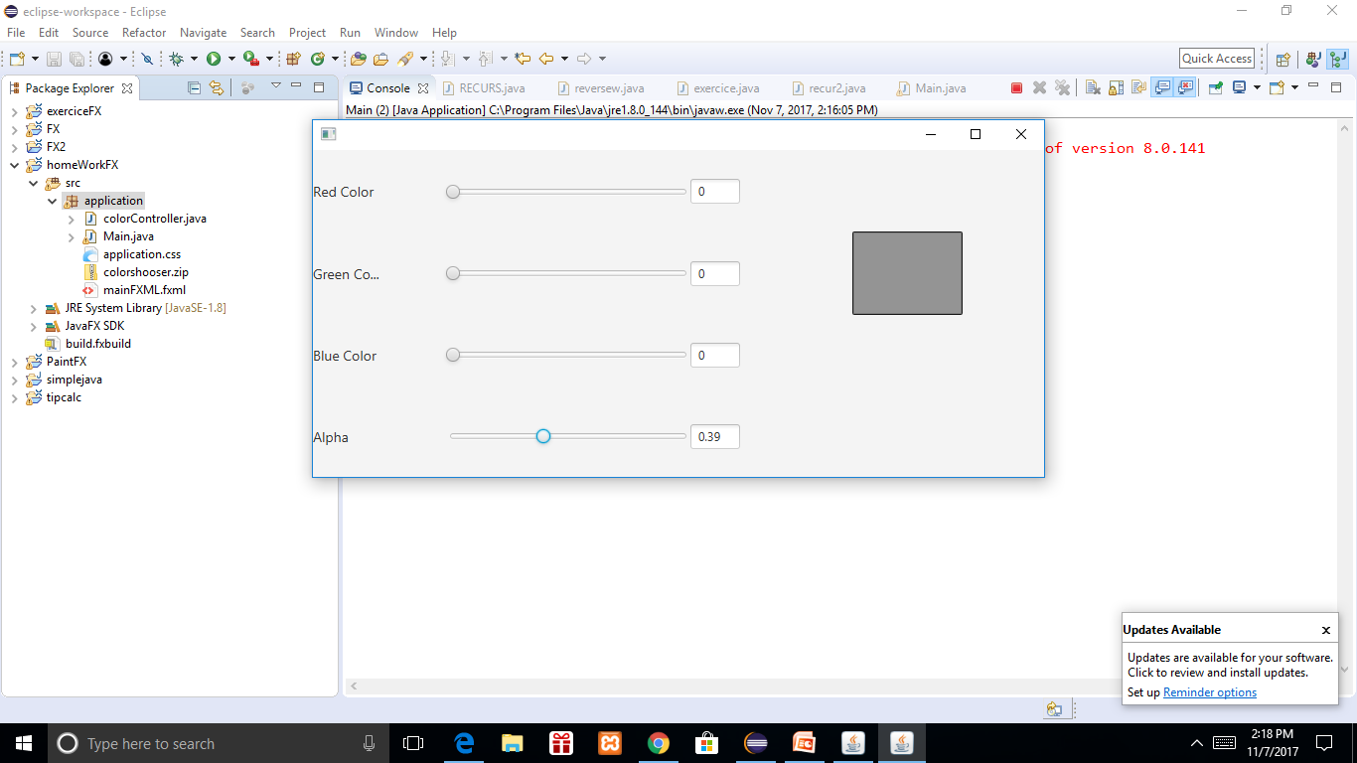
As the alpha slider changes, the box becomes darker

Slide 7
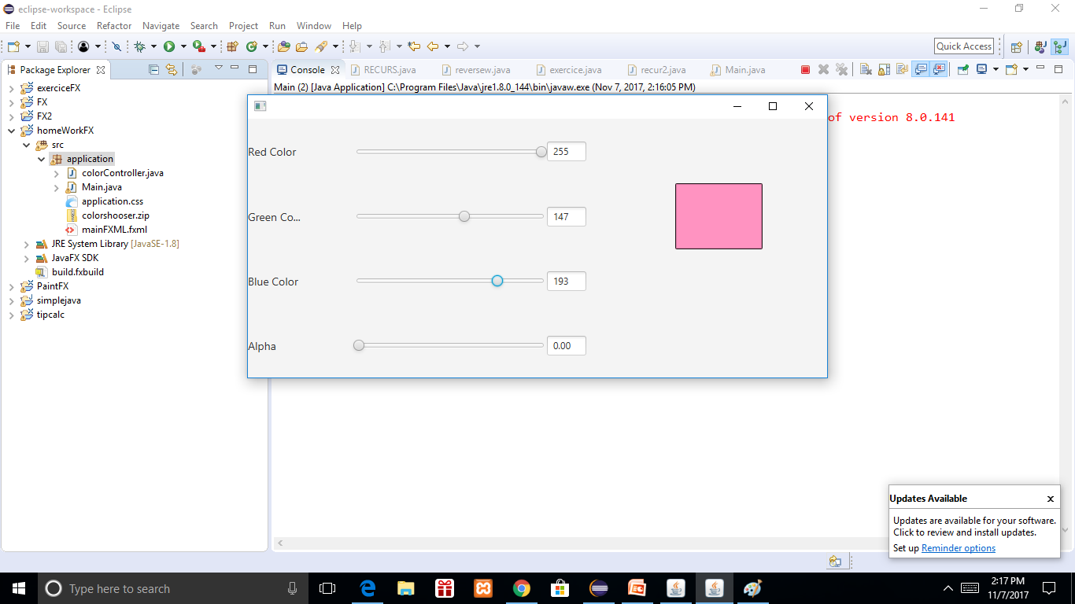
Here’s an example with all the color sliders in various positions.

Slide 8
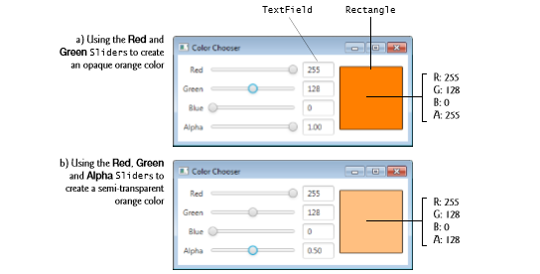
The values of the sliders cause the rectangle to change colors by setting the color to the corresponding RCBA color setting.

Slide 9
RGBA color system
RGBA color values are an extension of RGB color values with an alpha channel - which specifies the opacity of the object. An RGBA color value is specified with:rgba(red, green, blue, alpha). The alpha parameter is a number between 0.0 (fully transparent) and 1.0 (fully opaque).

Slide 10
For the red color, we implement the RCBA color this by setting the “redSlider” value to a listener. The observable value is the value the user sees on the screen. The “oldValue” is the value about to be change likewise the “new” Value is the value that HAS BEEN changed.
redSlider.valueProperty().addListener( (observableValue, oldValue, newValue) ->
{
red = newValue.intValue();
colorRectangle.setFill(Color.rgb(red, green , blue, alpha)); });

Slide 11
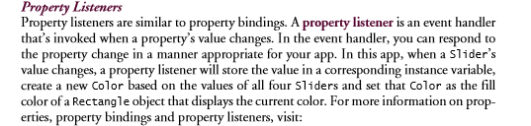
The listener concept is explained here by Pearson Education.

Slide 12
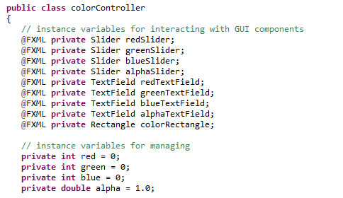
We start the program by building the Controller Class.

Slide 13
First instantiate the sliders for each element, Red, Green, Blue, and Alpha.

Slide 14
Next we create a text field so the user can see the value as it moves with the slider.

Slide 15
And a Rectangle field to connect the Gui rectangle to it’s RGBA value.

Slide 16
Create ints a doubles for the color to implement their RGBA value with the GUI.

Slide 17
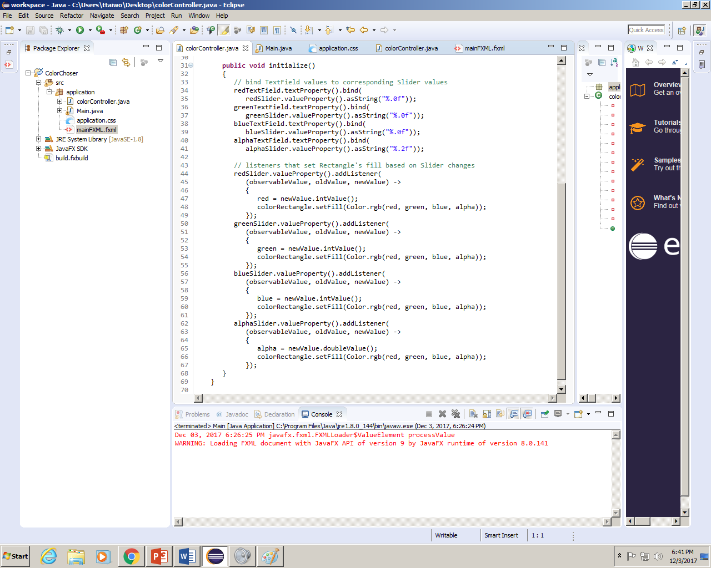
To initialize it together create a method called initialize and set the Color’s text field to a text property, bind it with the Slider’s value property and use as string to convert it into a string

Slide 18
Now add the Color’s Slider to a listener using the value Property. The observable value is the value the user sees on the screen. The “oldValue” is the value about to be change likewise the “new” Value is the value that HAS BEEN changed

Slide 19
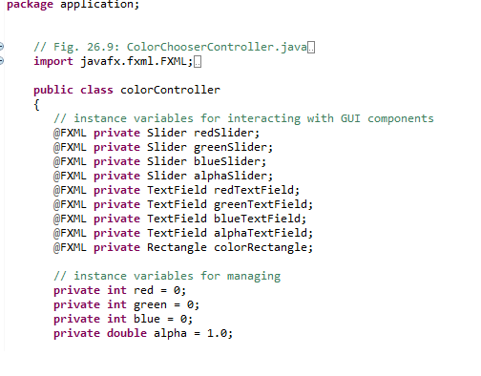
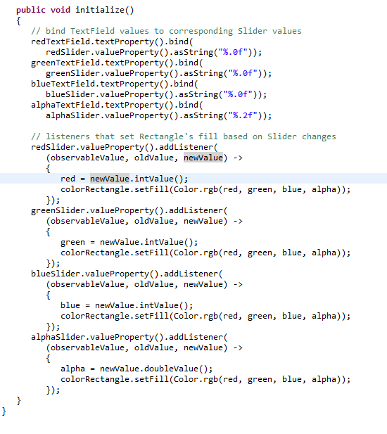
Now the Controller Class is complete.

Slide 20
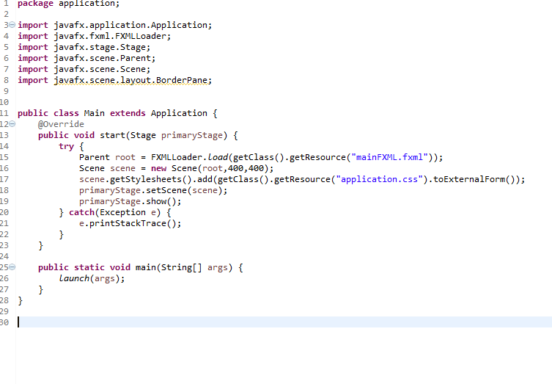
Now we make the Main.java file

Slide 21
Make sure it’s in the same package as your Controller Class.

Slide 22
It’s a standard main class just make sure your class is set to the proper fxml

Slide 23
BUILDING THE GUI

Slide 24
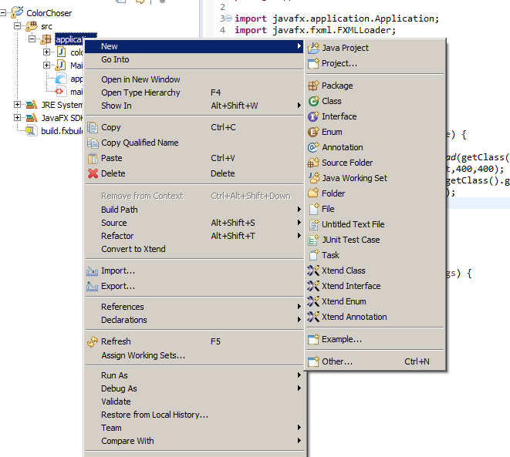
To start building the Gui right click on your package

Slide 25
Click New -→ Other

Slide 26
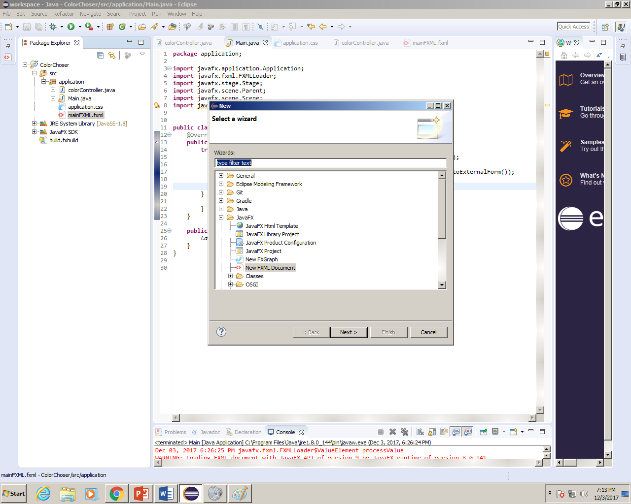
Circle the Document entitled “New FXML
Document”

Slide 27
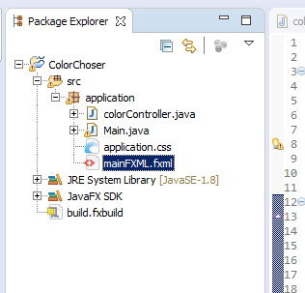
Right click on the created FXML File.

Slide 28
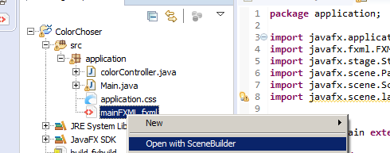
And hit “Open with Scene Builder”

Slide 29
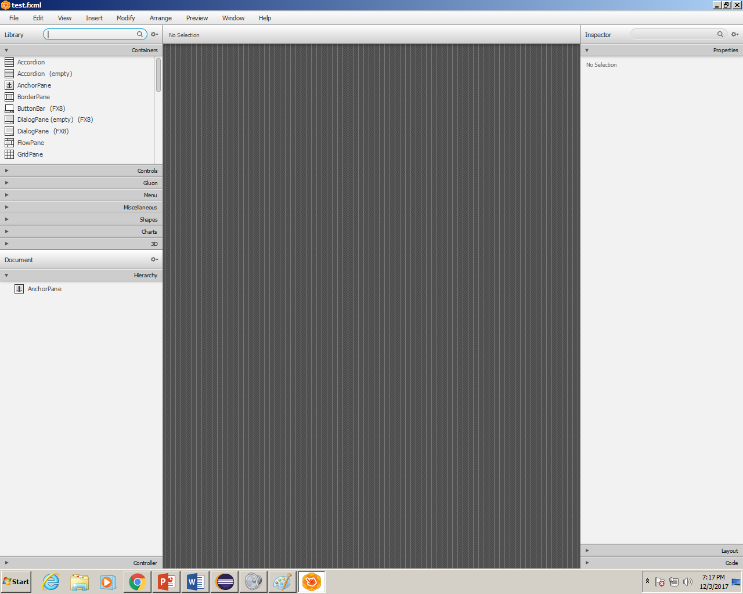
You should be taken to a screen like this

Slide 30
Delete this “ArchorPlane” Herachy

Slide 31
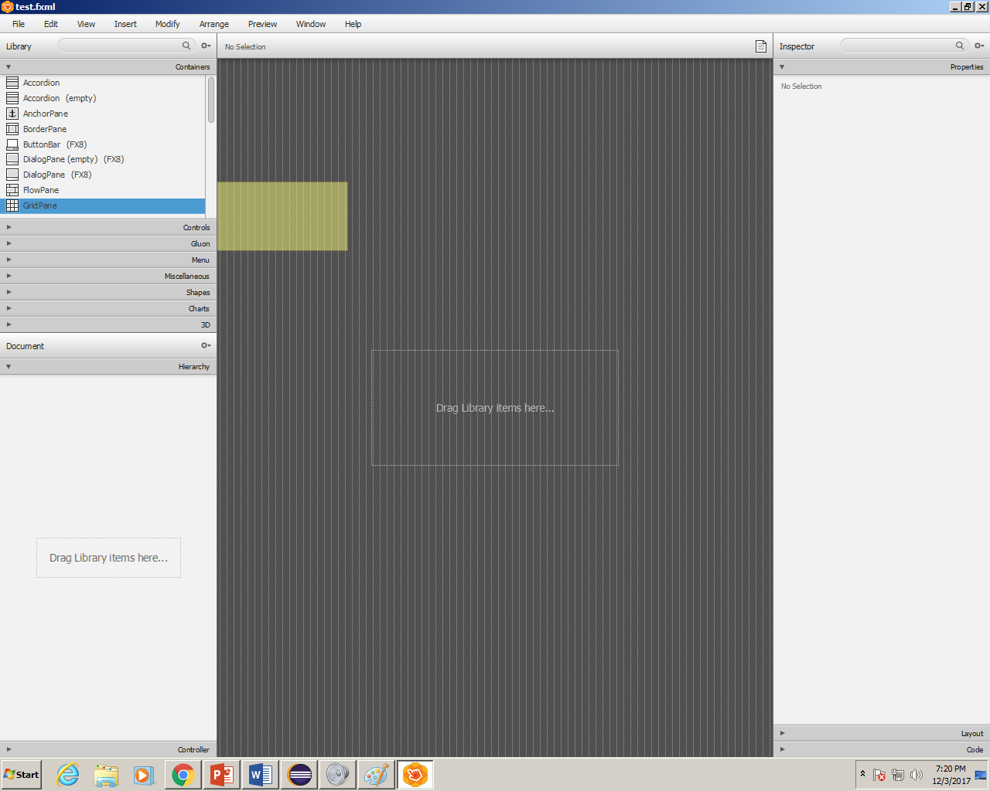
And drag a Grid Plane into the canvas

Slide 32
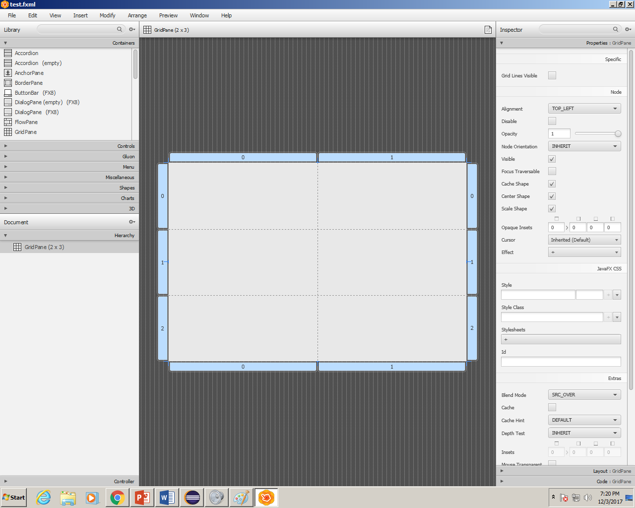
Should look like this…

Slide 33
If you can recall, the final product should look like this

Slide 34
So instead of a 2x3 gridplane, we’re gonna need to change it to 4x4

Slide 35
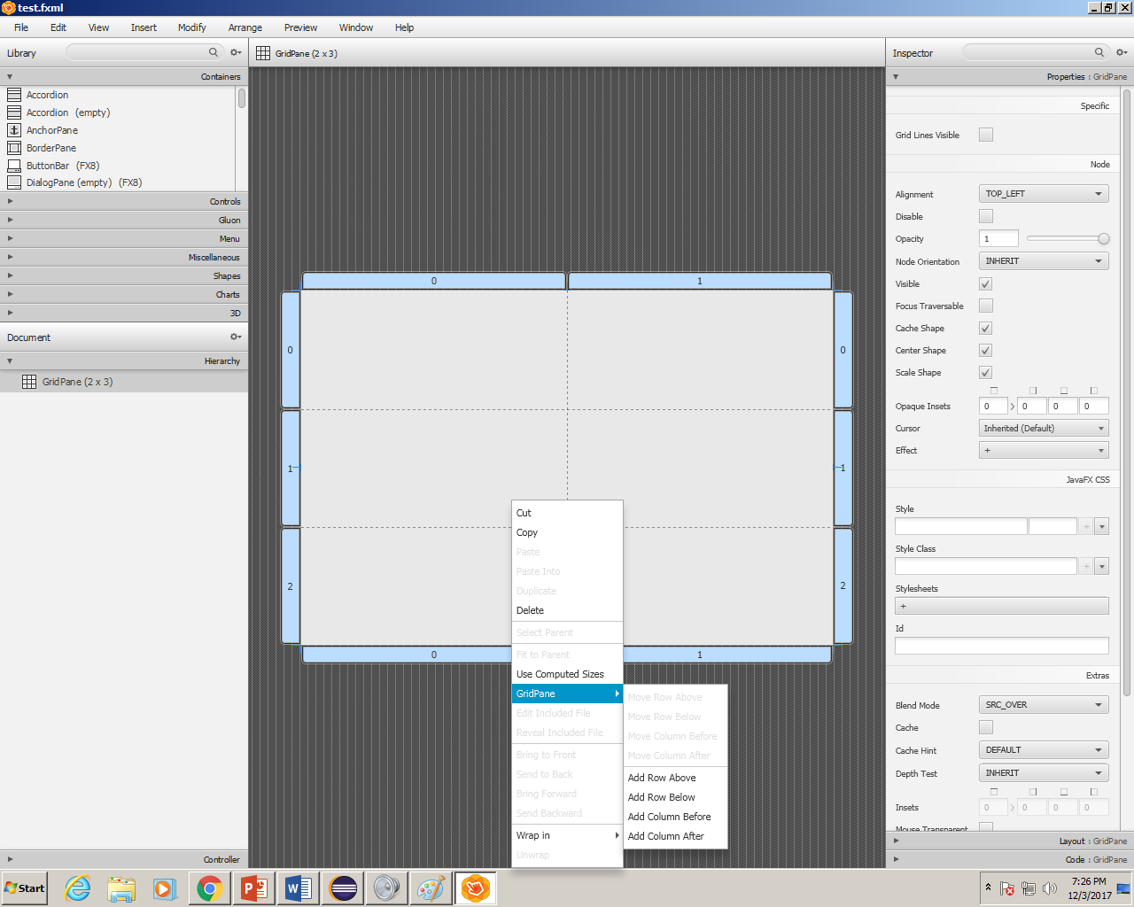
To do this, right click on the grid plane, select the “Grid Pane Option and add 2 columns and 1 row.

Slide 36
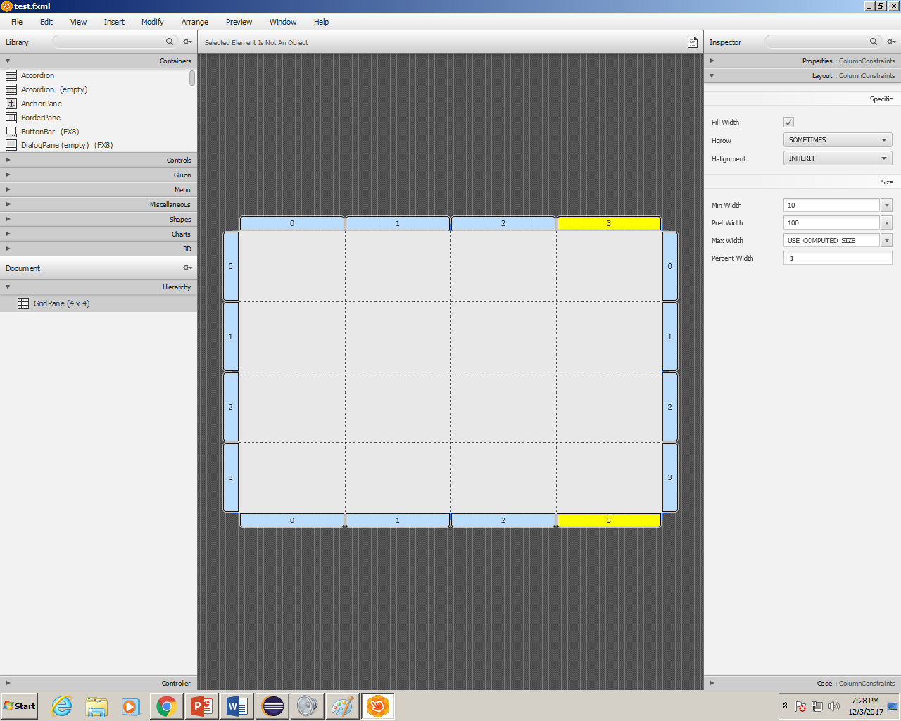
Now it should look like this…

Slide 37
Next we’re going to add labels to the first Column.

Slide 38
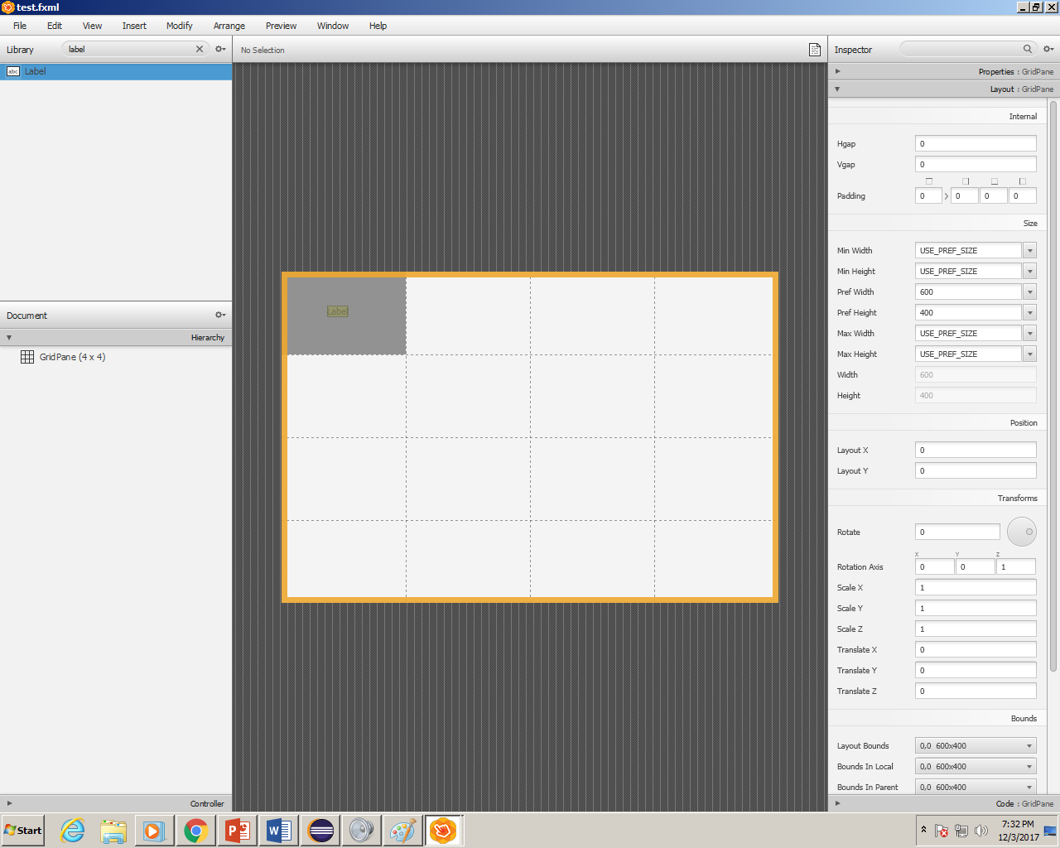
Type label into the search and add the element to Grid(0,0)

Slide 39
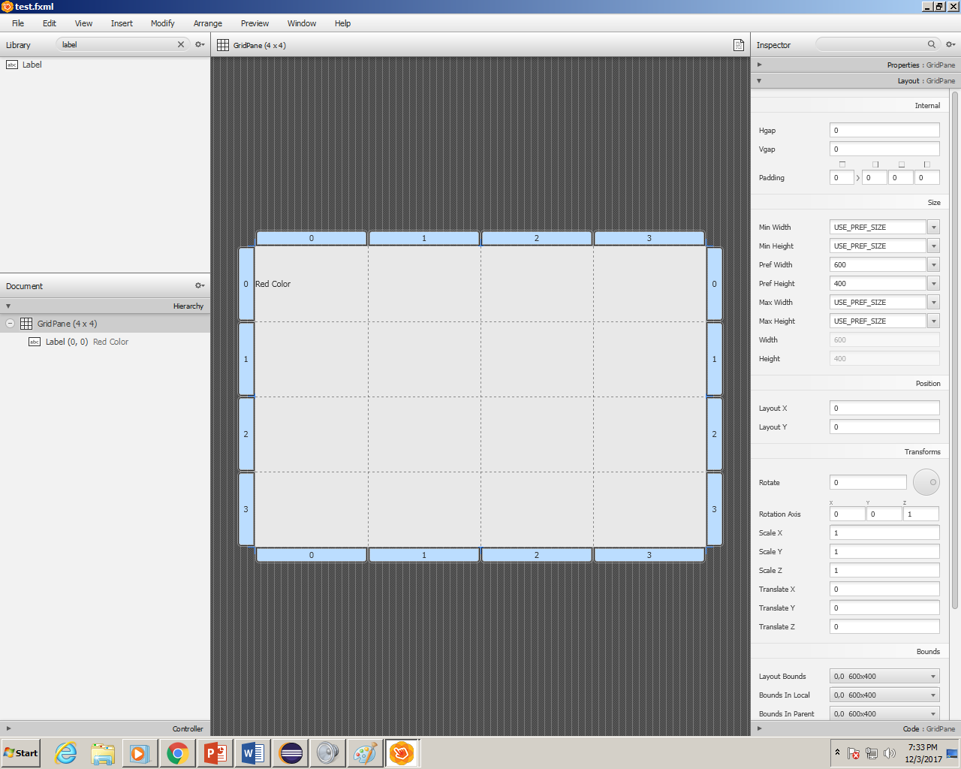
Type “Red Color” into the field and repeat for the other elements.

Slide 40
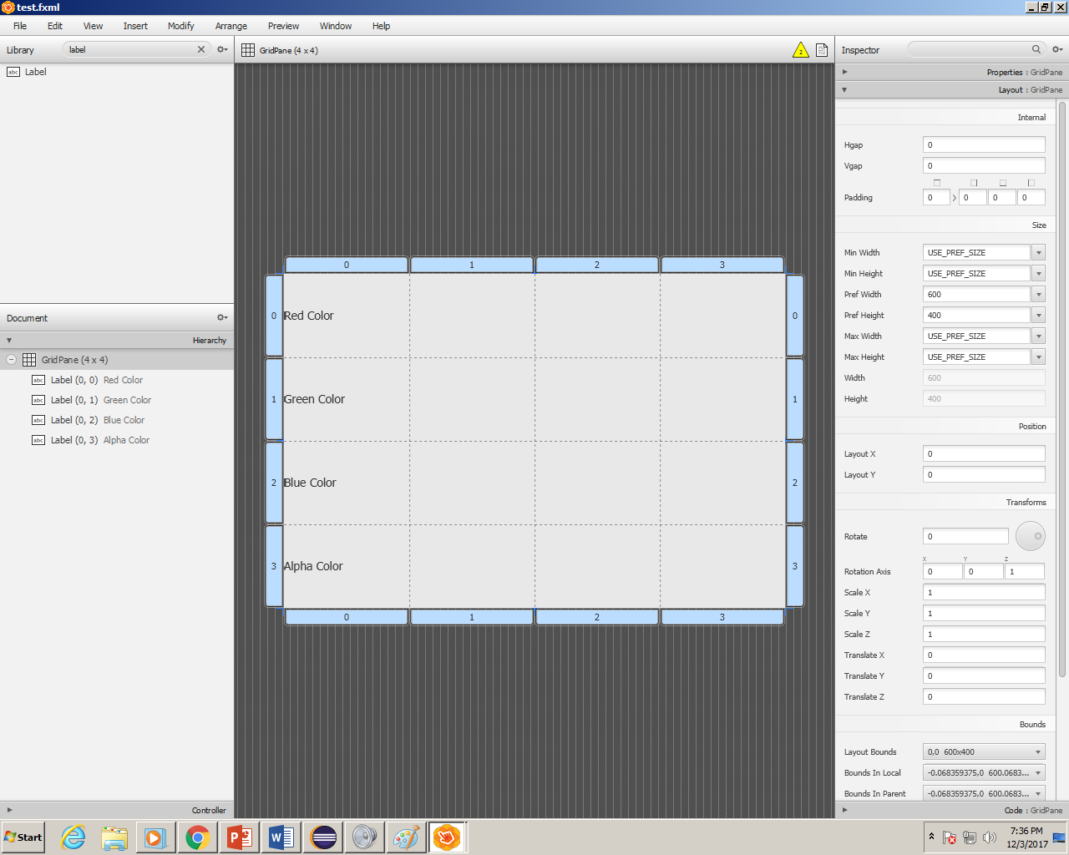
Your SceneBuilder should now look like this.

Slide 41
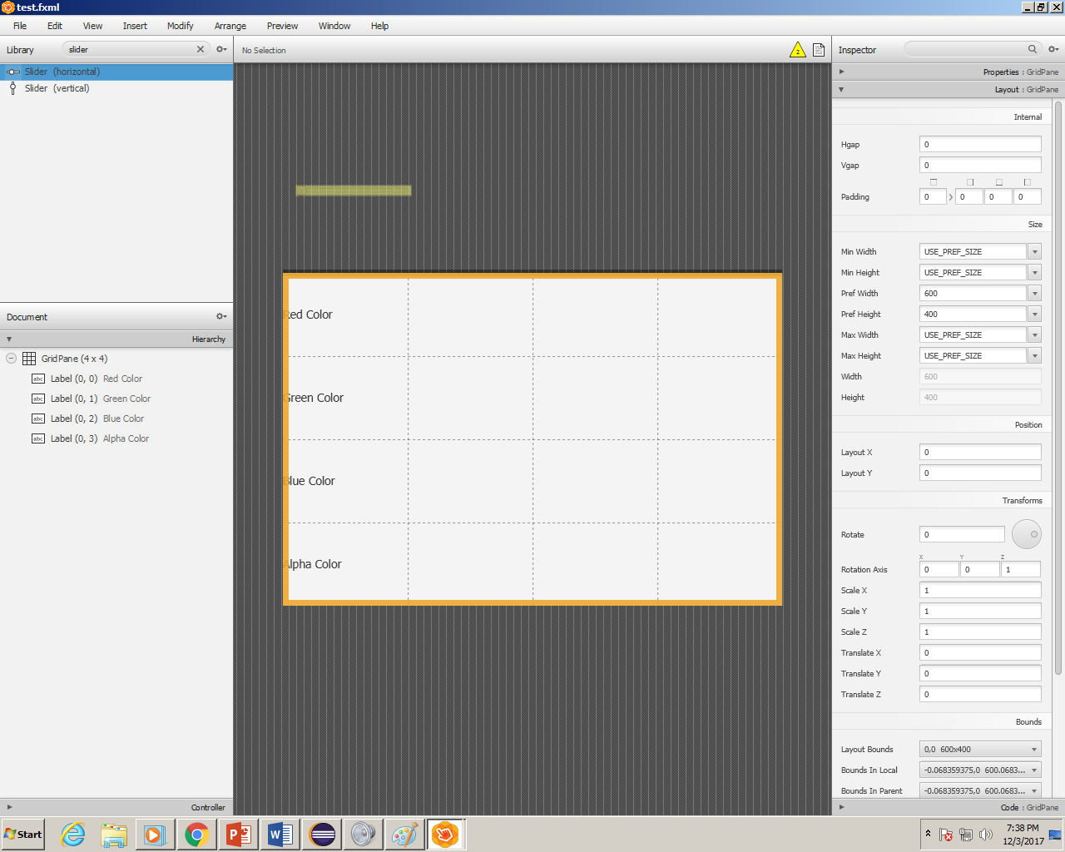
Now we add the slider, type “slider” into the search. And drag it into (1,1)

Slide 42
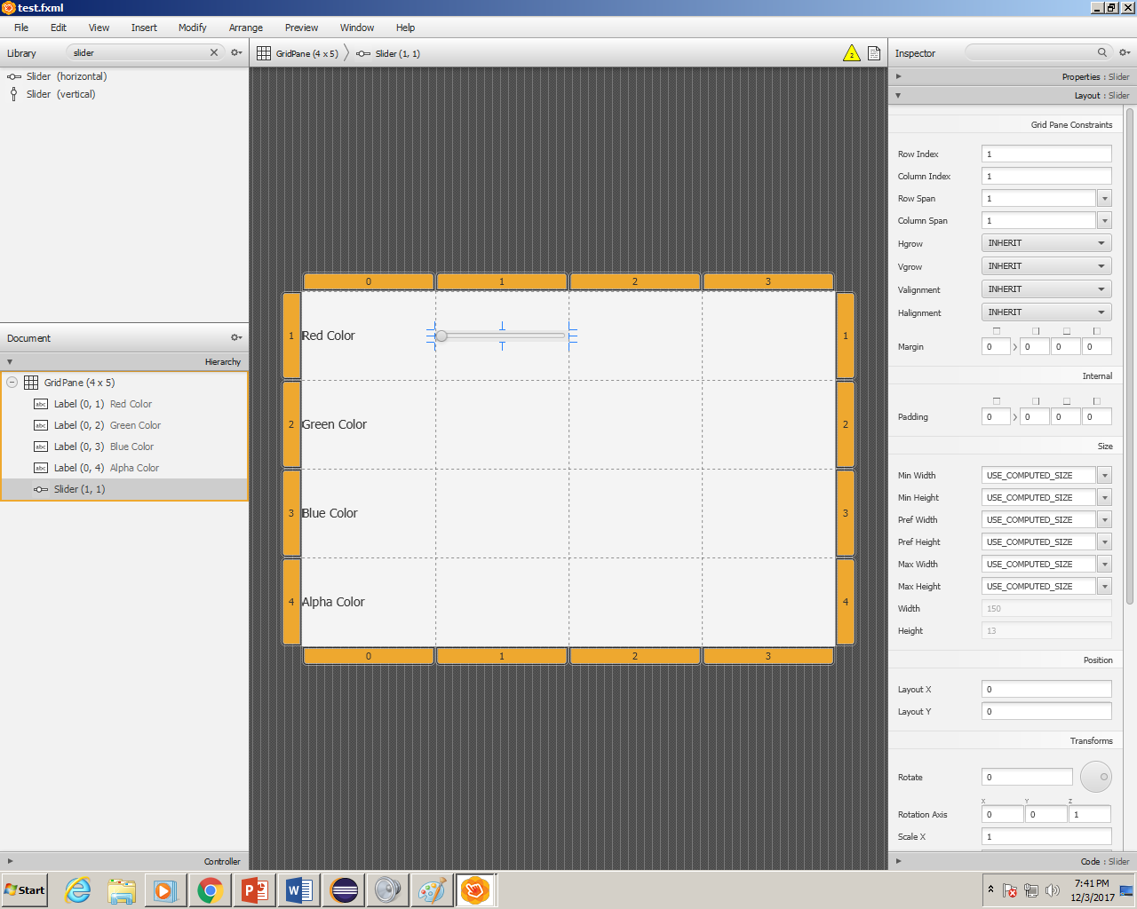
Paste like this for the other 3

Slide 43
Paste like this for the other 3

Slide 44
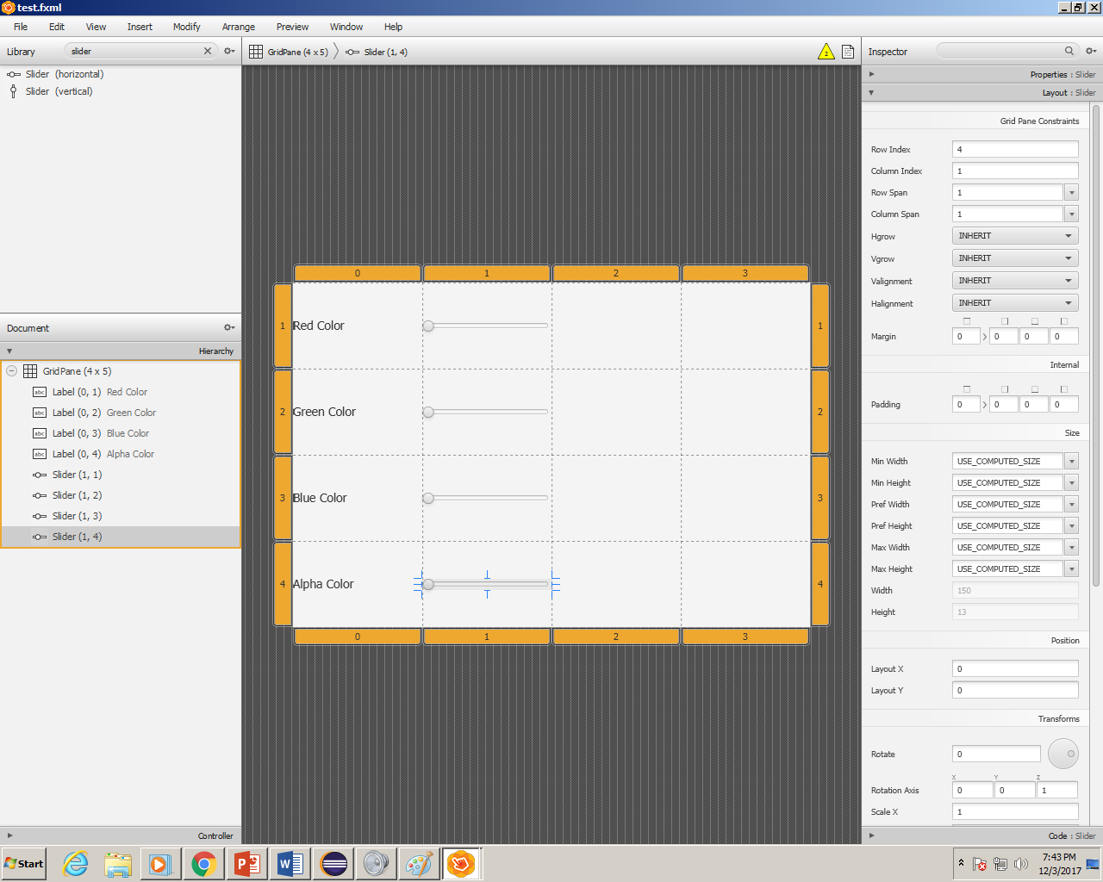

Slide 45
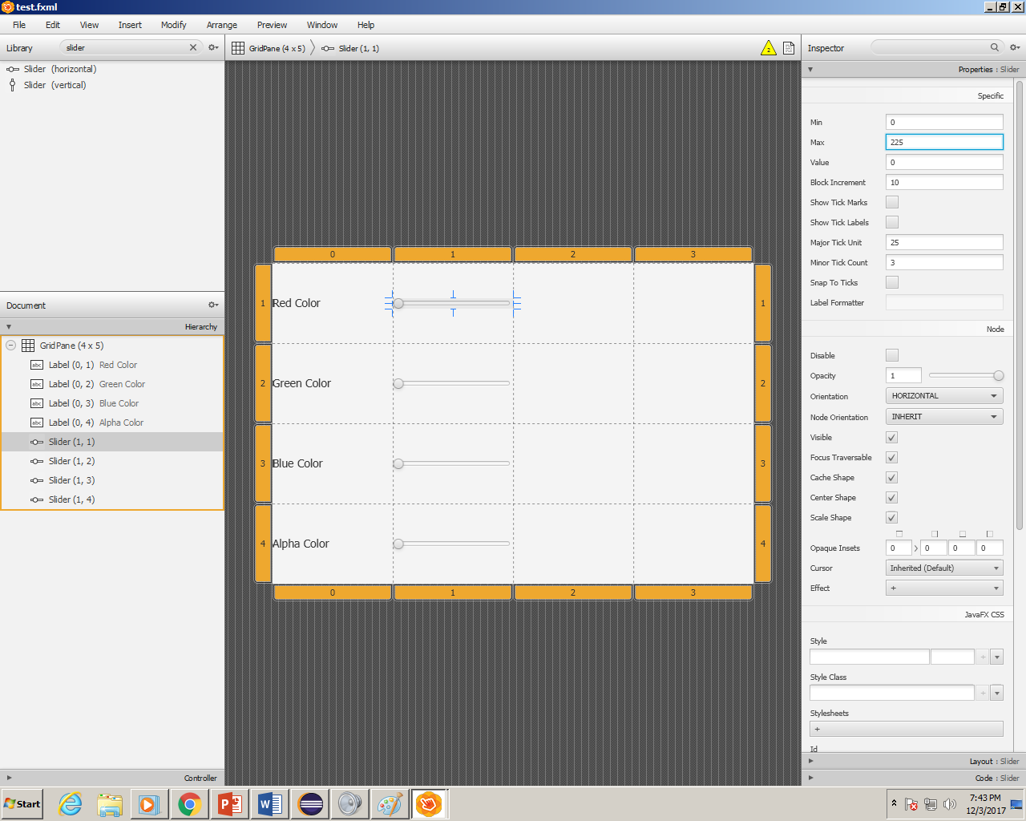
For the Red, Green and Blue sliders set the “Max Property” to 225

Slide 46
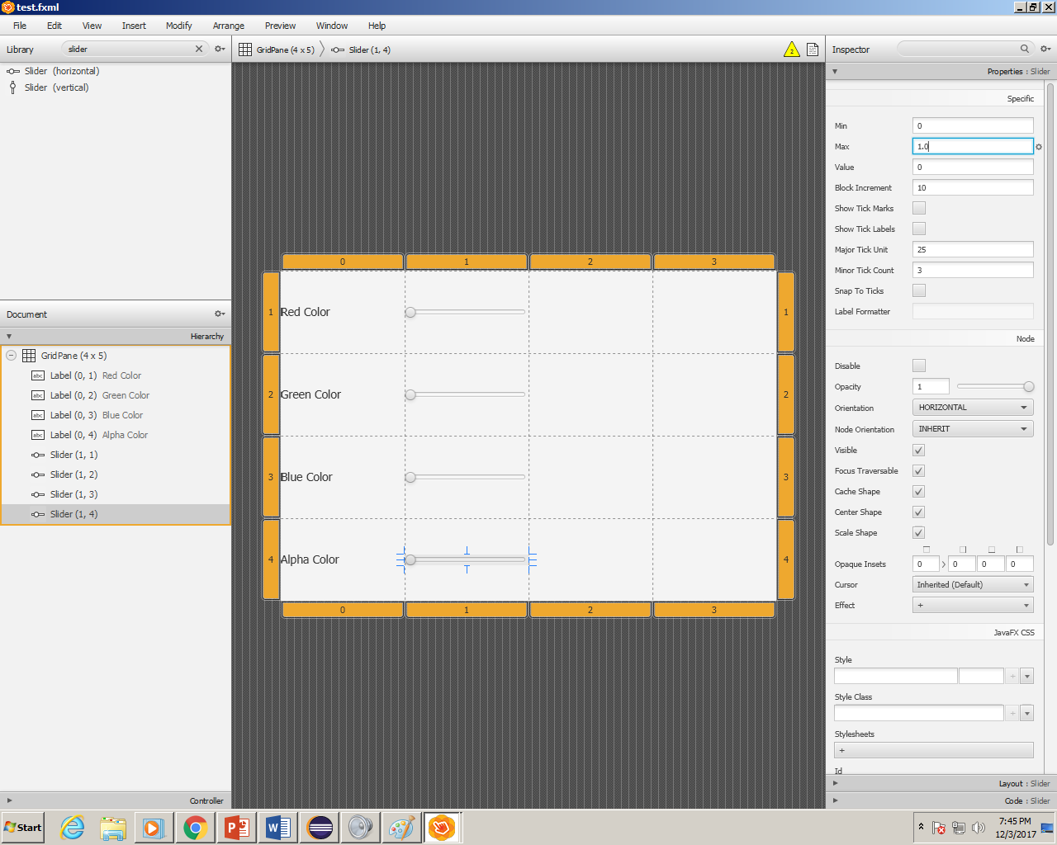
For the Alpha Slider set it’s max property to 1.0

Slide 47
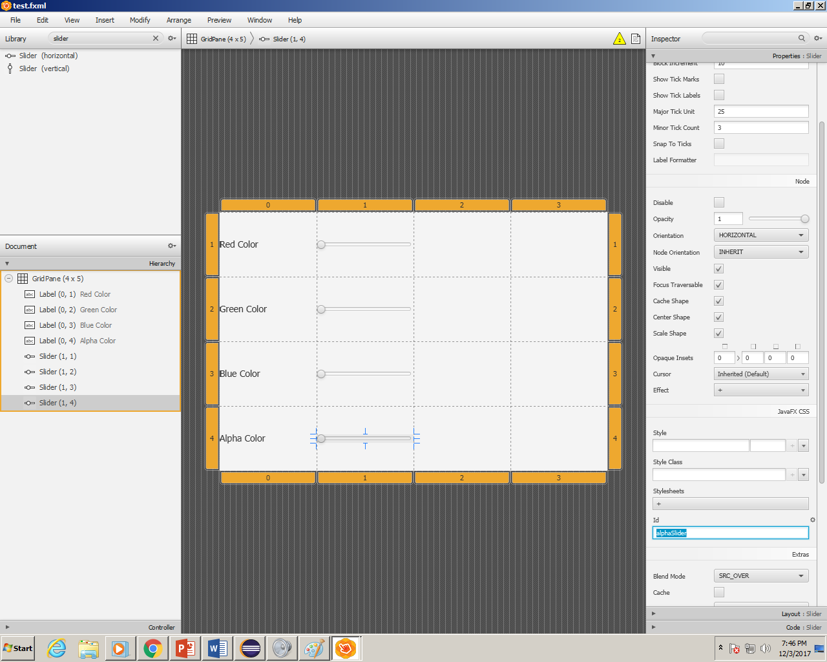
Be sure the fx:id is set to the proper variable for the sliders. For the alpha slider you’d set it to alphaSlider and for the RedSlider = redSlider…and so forth.

Slide 48
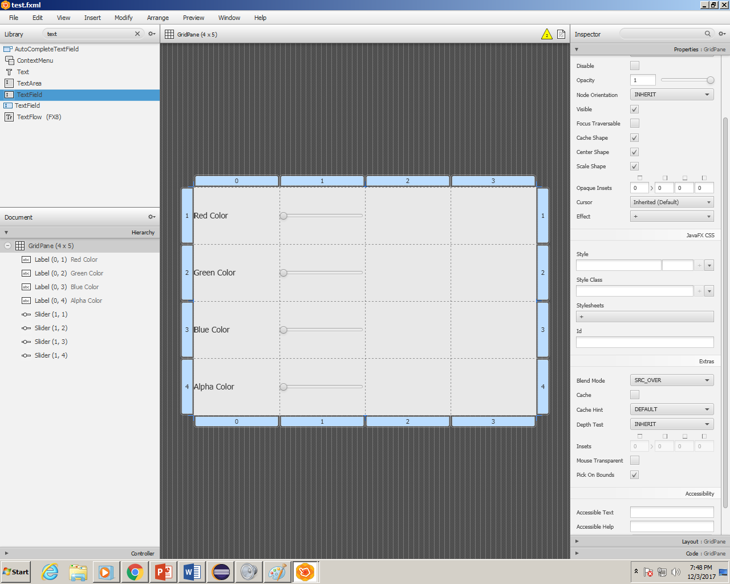
The 3rd column will be for the text fields.

Slide 49
Type “textfield” into the search and drag it in like the previous items.

Slide 50
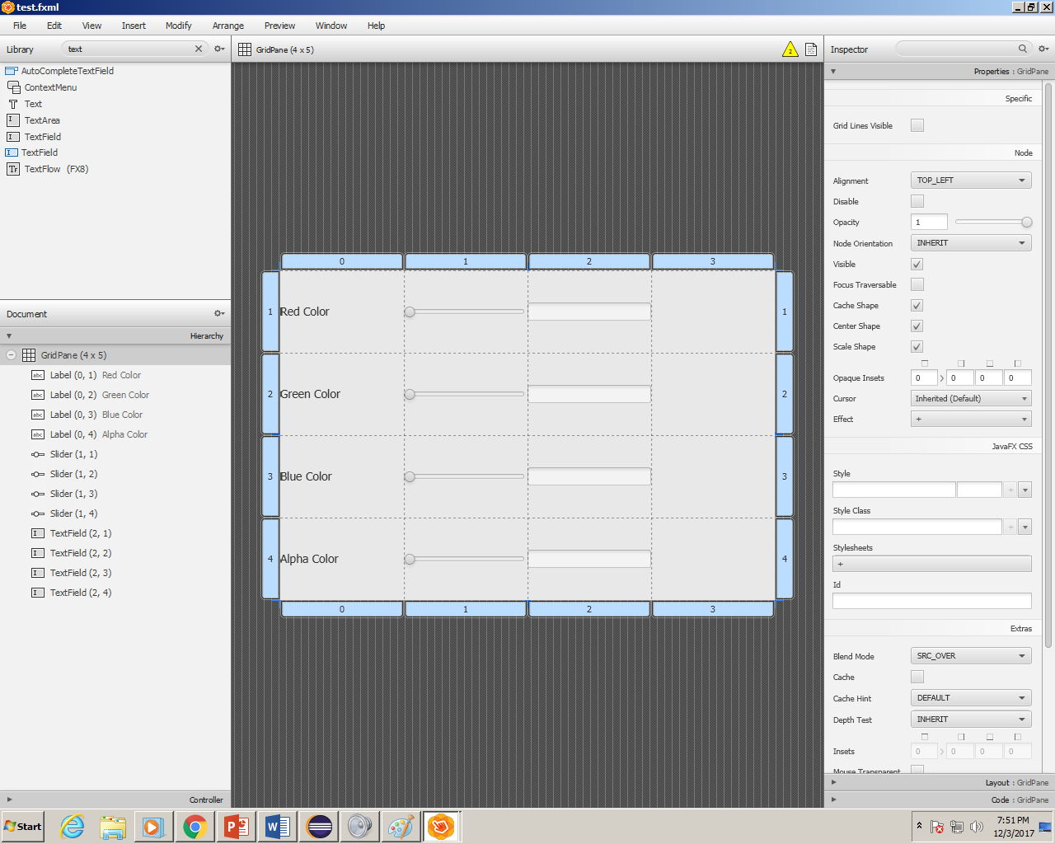
Your Gui should look something like this.

Slide 51
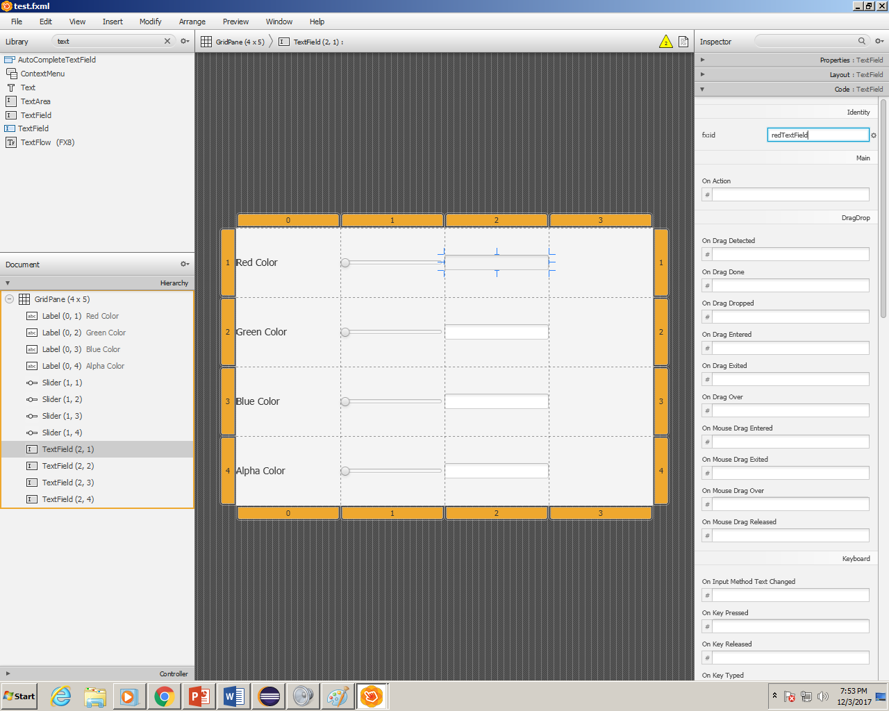
Make sure the fx:id for the textFields are correct! Ex(redTextField, greenTextField)

Slide 52
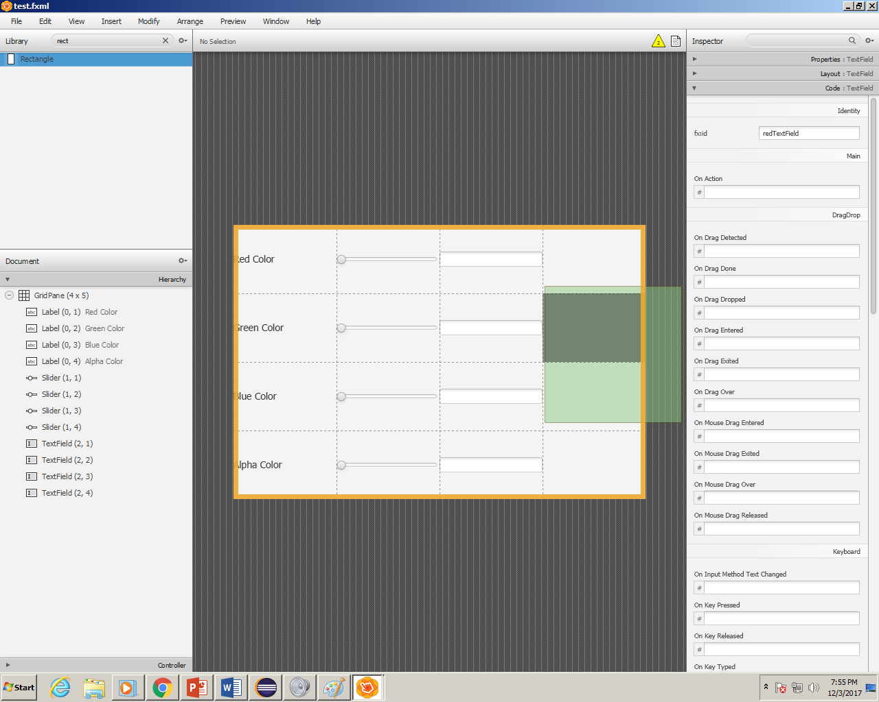
Now we configure the Rectangle, type Rectangle into the search bar and drag it into the canvas.

Slide 53
Now we configure the Rectangle, type Rectangle into the search bar and drag it into the canvas.

Slide 54
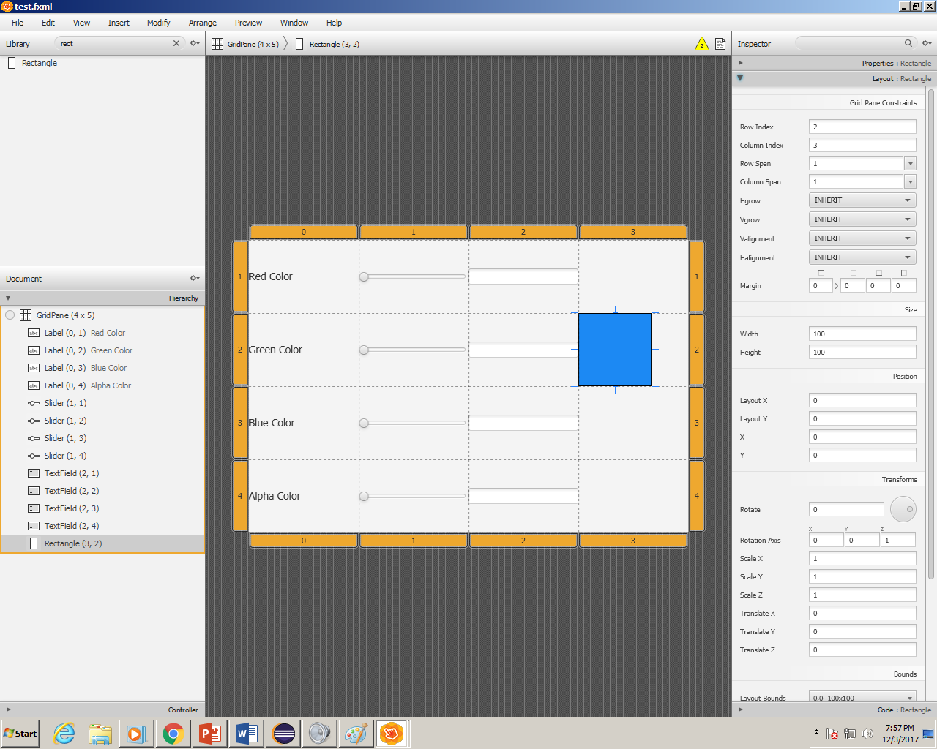
Set the width and height to 100

Slide 55
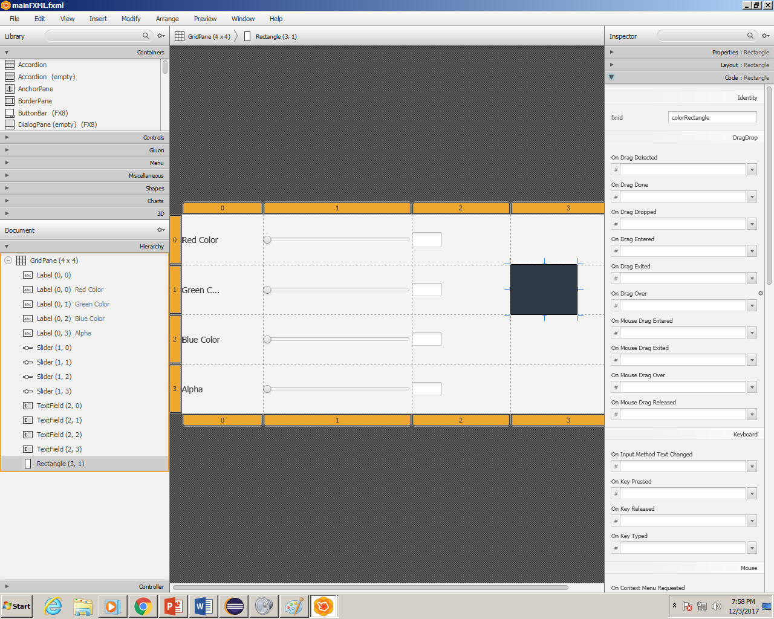
In the code section make sure the fx:id is set to “colorRectangle”.

Slide 56
Final Gui should look SIMILAR to…

Slide 57
Hit Ctrl + S to save your .fmxl Document. Then close it.

Slide 58
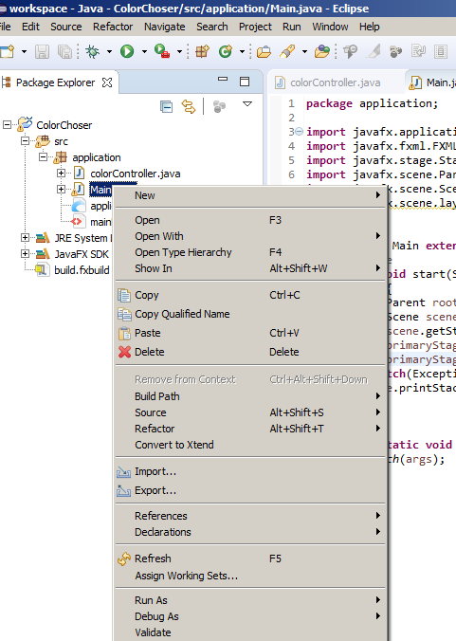
Right click on your Main.java file and select Run As.-→

Slide 59
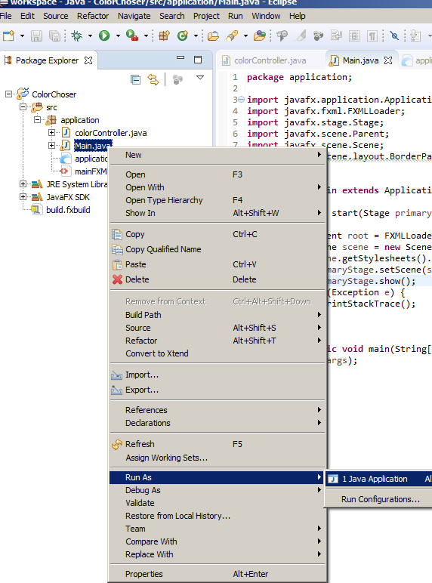
Hit run as-→ Java Application

Slide 60
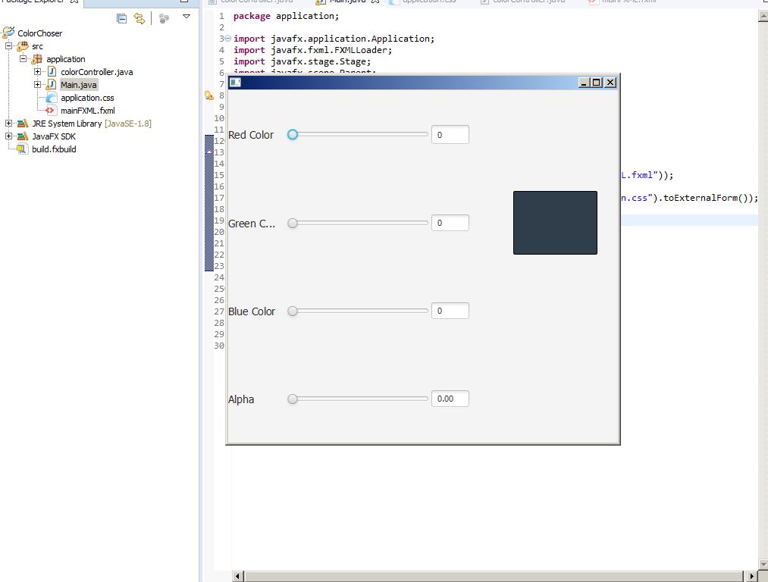
Your final project should come up

Slide 61
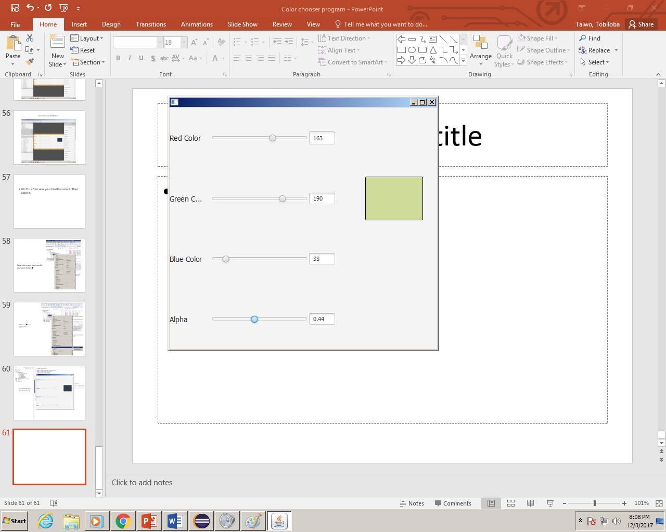
With full functionality for all the texts fields and sliders.

